Slide 1
EV Charging Station Analysis
Hector Pena
DSC 680
Bellevue University

Slide 2
Business Problem
With the growing popularity of Electric Vehicle (EV) we need more EV charging stations to be built across the United States this project will take a deep dive into EV Charging stations. For the consumers they want to see a breakdown of the EV charging stations so they can make an informed decision as to if having an Electric Vehicle is a smart choice for them. An analysis that emphasizes the reliability of these charging stations and the networks which own said charging stations, will try to answer the questions of how reliable the charging stations are. With the vast majority or charging stations being outside there is a possibility that external factors may affect the reliability.

Slide 3
Background
When looking back at the late 1800’s we can see the introduction of electric vehicles, which brings the experimentation of vehicle charging. In the early forms of experimentation EV had removable batteries that had to be changed manually or at battery stations. Moving to the 19th and early 20th century the sales of EV increased in popularity owners have started installing EV chargers at their homes, public charging stations have become more accessible.
Late 20th century shows us automakers experimenting with EVs especially in the state of California. The 2000’s showed the first charger capable of fully charging EVs in several hours.
With the expansion of vehicle manufactures launching more EV; such as Nissan Leaf. Tesla Model S, etc. The charging infrastructure expanded rapidly causing companies and government to invest in networks of chargers across cities.

Slide 4
Data Explanation
The data we will be using for this project has been collected from Kaggle, this dataset provides 33 different metrics that range in category. This dataset will help us see metrics such as time, location, average charge time, type of chargers, number of ports, etc. which we can use to show EV owners any trends or useful information to make educated decisions on their EV charging needs. To get the most of our data we must perform basic EDA to remove any irregularities in our data as well as fill any null values that may be in place. We will also filter our data to segment it by columns so we can get a closer look at certain metrics.

Slide 5
Methods of Analysis
With this dataset we have a wide range of potential of many types of analysis, with the metrics listed in this dataset we can run a Time Series Forecasting. This will predict EV station availability and peak demand hours. With using classification, we can determine if a charger will be available at a given time. With running a regression model, we can try to predict utilization rates and wait times for EV stations. A clustering model can be used to segment stations by usage patterns and location type. By running anomaly detection, we can try to identify maintenance issues or unusual demand spikes that affect EV stations. With a correlation analysis, we can explore relationships between weather, gas prices, traffic, and EV charging demand. With the use of dynamic pricing optimization, we can model pricing strategies based on demand patterns. With the use of visualizations, we can create a compelling EV infrastructure dashboards and maps to show consumers different metrics. With all these methods we can help to identify underserved areas and optimize locations for new EV charging stations.

Slide 6
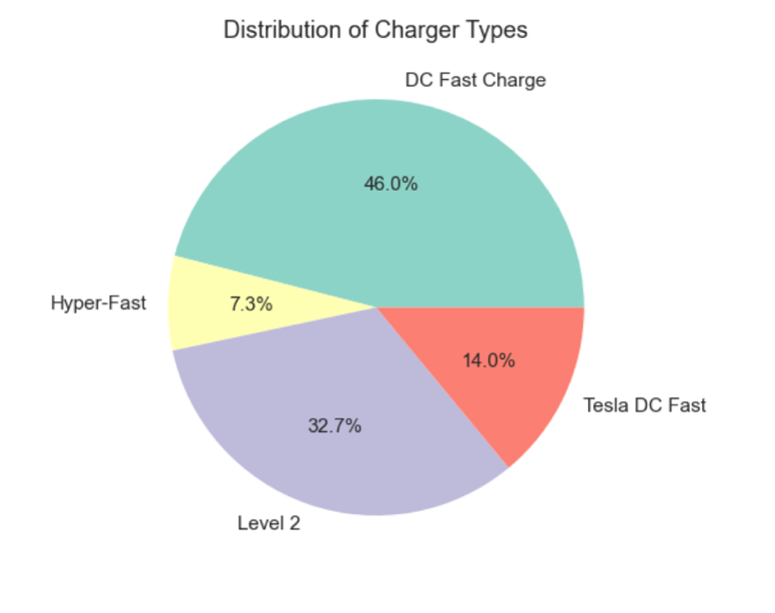
Charger Type Distribution
After using the methods from above we can see the distribution of charger types showing that over 40 percent of our chargers are DC fast chargers while Tesla DC-Fast only take up around 14 percent of charger types. Below we can see the breakdown of our charger types.

Slide 7
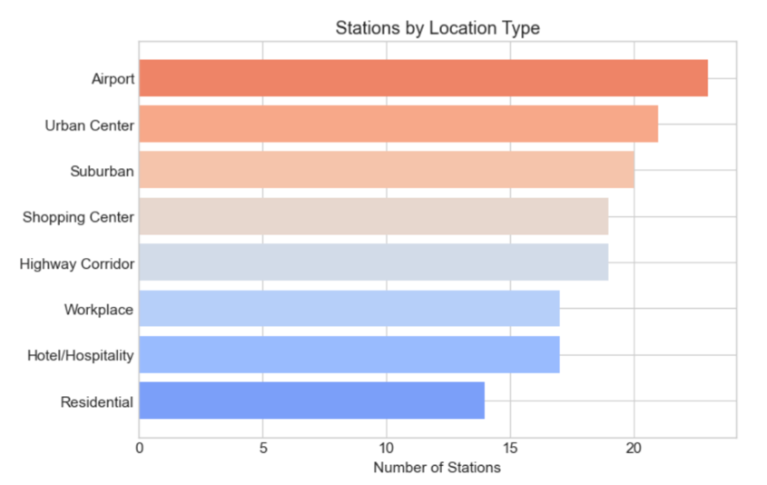
Charger type Distribution
Looking into the location of these chargers we can see that most chargers falling under the airport category compared to Residential chargers that take up around 70 percent of locations. We can see the breakdown below showing our Charging Station Locations.

Slide 8
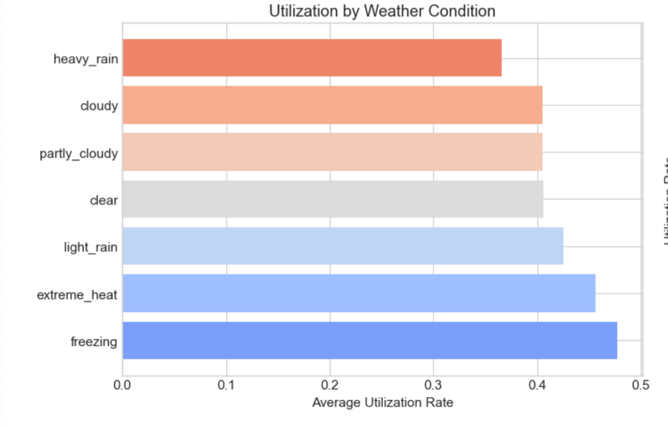
Weather Condition Distribution
Lastly, we can see the utilization rate of EV chargers regarding weather conditions, we can see that most of the utilizations for EV charges seem to be when weather conditions are freezing and there is a decrease in utilization when weather conditions are heavy rain. We can see the breakdown a breakdown of the Utilization by Weather Condition.

Slide 9
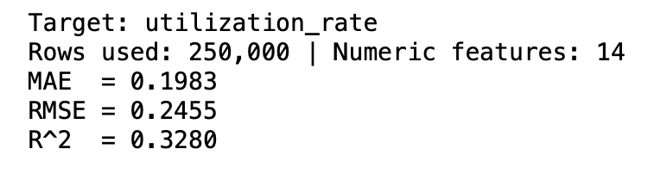
Correlation Analysis
With using a correlation analysis that focuses on the utilization rate of the parameters we can see that we have a MAE close to zero which shows a good correlation analysis.
While our R^2 is not the strongest in the following Correlaiton Analysis we will add parameters to help improve our score

Slide 10
What Drives Utilization?
Rank | Feature | Direction | Business Meaning
1 | hour_of_day | ↑ | Charging demand is strongly time-driven
2 | traffic_congestion_index | ↑ | Commute congestion increases charging usage
3 | gas_price_per_gallon | ↑ | Higher gas prices → more EV charging
4 | avg_session_duration_mins | ↑ | Longer sessions associate with higher utilization
5 | ports_total | ↑ | Larger stations attract more usage
6 | current_price | ↑ (weak) | Slight relationship with demand
7 | longitude | ↓ | Geographic usage differences
8 | day_of_week | ↓ | Slight weekday/weekend pattern
Utilization is primarily driven by time-of-day patterns and traffic congestion.
Economic conditions like gas prices also influence charging behavior.
Station size and session length play moderate roles, while weather and precipitation have minimal impact

Slide 11
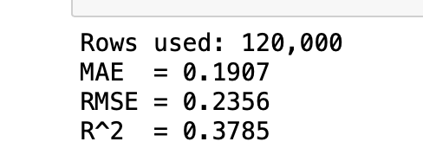
Correlation Analysis Cont.
Focusing on Charger Type and Network Type we can see a change in the correlation analysis.
This slight change in the MAE RMSE and R^2 shows us a meaningful lift just by adding these two structured categorical features

Slide 12
Network Matters A lot
Rank | Feature | Impact Direction | Interpretation
1 | network_Volta | ↑↑ | Very strong utilization effect
2 | network_ChargePoint | ↑ | Higher usage relative to baseline network
3 | current_price | ↑ | Pricing strongly associated with demand
4 | network_EVgo | ↑ | Network-level utilization differences
5 | network_EVCS | ↑ | Same — network operational impact
6 | network_Tesla Supercharger | ↑ | Strong brand/infrastructure effect
7 | charger_type_Tesla DC Fast | ↑ | Fast Tesla chargers drive usage
8 | hour_of_day | ↑ | Time-of-day remains critical
9 | traffic_congestion_index | ↑ | Commute effect still strong
10 | gas_price_per_gallon | ↑ | Economic substitution effect
By adding Charger Types and Network Type we can see utilization differences across networks and network parameters are stronger than most numeric drivers.
Infrastructure quality
Location strategy
Brand ecosystem effects

Slide 13
Network Matters A lot Cont.
Charger Type Impacts Demand
Tesla DC Fast have higher utilization
Level 2 shows moderate increase
Hyper-Fast show slightly negative relative to baseline
Fast charging ecosystems clearly matter
Economic + Traffic Factors Still Important
Gas prices
Congestion
Time-of-day
EV charging is heavily commute-driven.

Slide 14
Conclusion
Utilization for EV Chargers is driven primarily by network ecosystem effects, charger type, and time-of-day traffic patterns. Network brand differences explain more variation than weather or geography. Fast charging networks show significantly higher utilization.

Slide 15
References:
Kurti, A. (2024, May 28). History of electric charging stations: A journey through time between innovation and sustainability. Free To X - PROD. https://freeto-x.it/en/article/history-of-electric-connectors/?utm_source=chatgpt.com
Rodolfo. (2023, September 30). The history of EV charging infrastructure - EZ EV Electric. EZ EV Electric - EZ EV Electric Helping You Install And Launch Smart Electric Vehicle Charging Stations. https://www.ezevelectric.com/the-history-of-ev-charging-infrastructure/
Wikimedia Foundation. (2026a, January 17). Chargepoint. Wikipedia. https://en.wikipedia.org/wiki/ChargePoint?utm_source=chatgpt.com
Wikimedia Foundation. (2026, January 28). SAE J1772. Wikipedia. https://en.wikipedia.org/wiki/SAE_J1772?utm_source=chatgpt.com

